Slide 1
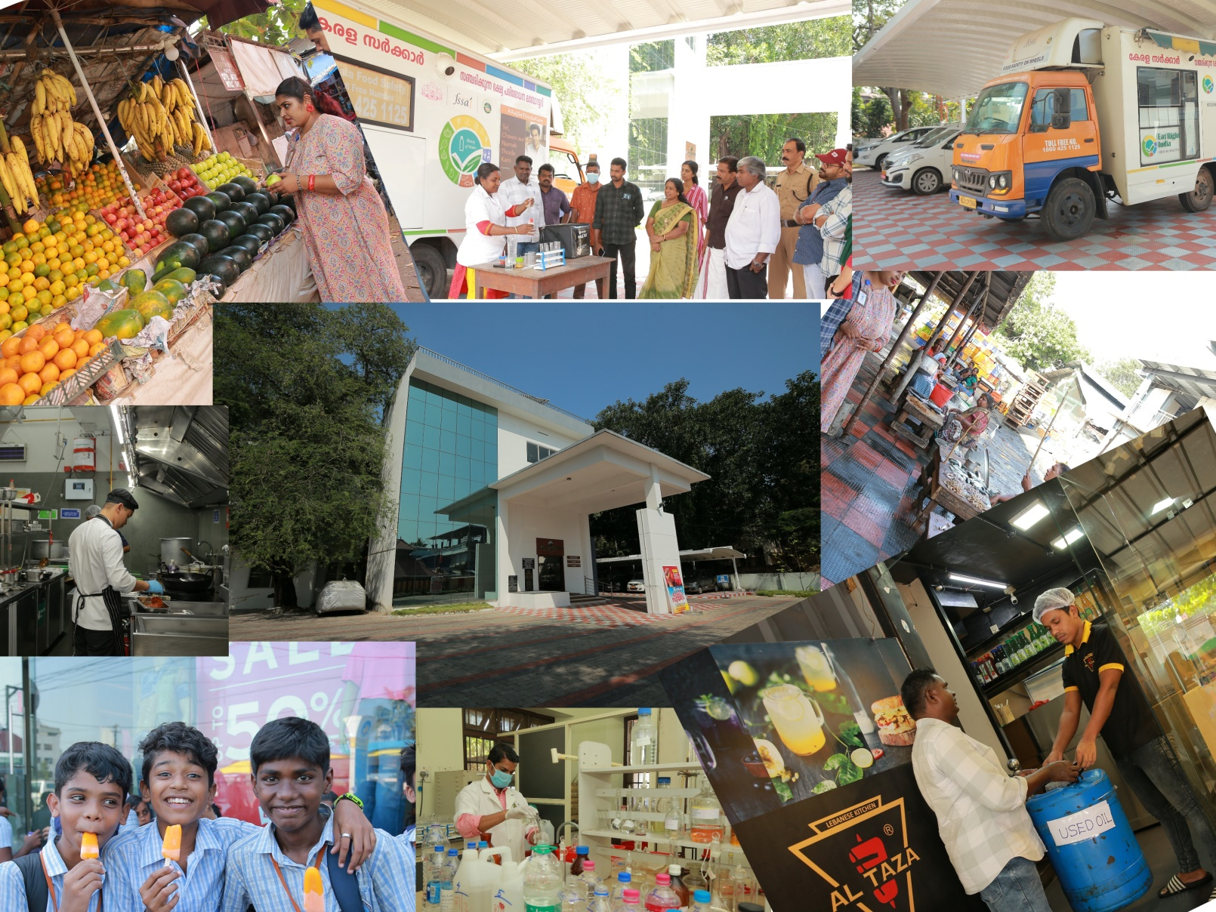
DEPARTMENT OF FOOD SAFETY, KERALA
FACT SHEET- 2024 (APRIL - SEPTEMBER)

Slide 2
"Enforcement, Analysis and Awareness: How We Protect Your Food"
The Food Safety Department of Kerala is committed to ensuring the safety of food consumed by the public. Over the last 6 months, the department has conducted rigorous enforcement activities and organized extensive awareness programs to educate food business operators (FBOs) and the public about food safety regulations and best practices.

Slide 3
Enforcement Activities
Table 1: SURVEILLANCE INSPECTIONS CONDUCTED
District | NO.OF SURVEILLANCE SAMPLES
 | APRIL | MAY | JUNE | JULY | AUGUST | SEPTEMBER
TVM | 401 | 341 | 386 | 379 | 362 | 329
KLM | 265 | 255 | 290 | 293 | 293 | 327
PTA | 160 | 74 | 98 | 115 | 116 | 64
ALP | 271 | 281 | 221 | 192 | 283 | 253
KTM | 245 | 196 | 179 | 216 | 222 | 147
IDK | 79 | 76 | 113 | 113 | 111 | 112
EKM | 488 | 431 | 445 | 485 | 413 | 449
TSR | 313 | 273 | 251 | 329 | 308 | 295
PKD | 292 | 299 | 212 | 284 | 243 | 350
MLPM | 241 | 267 | 299 | 292 | 275 | 328
KKD | 407 | 338 | 326 | 362 | 386 | 304
WYND | 76 | 91 | 51 | 85 | 85 | 84
KNR | 231 | 230 | 220 | 274 | 257 | 231
KSGD | 10 | 49 | 51 | 51 | 42 | 92
TOTAL | 3479 | 3201 | 3142 | 3470 | 3396 | 3365

Slide 4
Table 2: INSPECTIONS CONDUCTED
District | NO.OF INSPECTIONS
 | APRIL | MAY | JUNE | JULY | AUGUST | SEPTEMBER
TVM | 490 | 528 | 625 | 576 | 634 | 630
KLM | 437 | 493 | 561 | 724 | 578 | 703
PTA | 221 | 211 | 168 | 228 | 257 | 292
ALP | 339 | 518 | 456 | 508 | 542 | 468
KTM | 346 | 362 | 387 | 487 | 435 | 235
IDK | 169 | 128 | 193 | 181 | 95 | 198
EKM | 499 | 652 | 859 | 1280 | 863 | 1041
TSR | 380 | 378 | 364 | 559 | 524 | 494
PKD | 415 | 454 | 523 | 649 | 588 | 758
MLPM | 171 | 296 | 401 | 400 | 491 | 509
KKD | 491 | 536 | 452 | 545 | 568 | 627
WYND | 134 | 104 | 91 | 130 | 96 | 207
KNR | 428 | 477 | 349 | 632 | 497 | 605
KSGD | 25 | 51 | 81 | 68 | 79 | 105
TOTAL | 4545 | 5188 | 5510 | 6967 | 6247 | 6872

Slide 5
Table 3: ENFORCEMENT SAMPLES LIFTED
District | NO.OF ENFORCEMENT SAMPLE
 | APRIL | MAY | JUNE | JULY | AUGUST | SEPTEMBER
TVM | 91 | 96 | 103 | 95 | 100 | 86
KLM | 70 | 74 | 71 | 71 | 72 | 72
PTA | 23 | 24 | 22 | 28 | 25 | 21
ALP | 63 | 65 | 63 | 56 | 67 | 70
KTM | 44 | 55 | 55 | 52 | 48 | 54
IDK | 21 | 23 | 30 | 33 | 28 | 28
EKM | 61 | 73 | 78 | 70 | 59 | 59
TSR | 55 | 52 | 57 | 45 | 59 | 60
PKD | 56 | 54 | 50 | 56 | 58 | 54
MLPM | 57 | 71 | 75 | 66 | 62 | 70
KKD | 82 | 65 | 83 | 98 | 96 | 80
WYND | 16 | 14 | 15 | 15 | 18 | 14
KNR | 63 | 59 | 50 | 64 | 63 | 60
KSGD | 14 | 15 | 14 | 15 | 14 | 15
TOTAL | 716 | 740 | 766 | 764 | 769 | 743

Slide 6
Table 4: NUMBER OF NON-CONFORMING SAMPLES LIFTED
District | NO.OF NON CONFORMING SAMPLE
 | APRIL | MAY | JUNE | JULY | AUGUST | SEPTEMBER
TVM | 10 | 12 | 12 | 18 | 6 | 12
KLM | 20 | 18 | 16 | 17 | 16 | 11
PTA | 2 | 2 | 0 | 8 | 5 | 3
ALP | 18 | 15 | 7 | 9 | 5 | 16
KTM | 7 | 7 | 8 | 2 | 2 | 8
IDK | 3 | 5 | 6 | 5 | 2 | 5
EKM | 14 | 14 | 12 | 23 | 12 | 8
TSR | 7 | 12 | 9 | 8 | 8 | 3
PKD | 6 | 13 | 21 | 13 | 15 | 2
MLPM | 12 | 20 | 16 | 20 | 27 | 14
KKD | 34 | 14 | 15 | 25 | 30 | 11
WYND | 2 | 5 | 2 | 5 | 0 | 1
KNR | 13 | 12 | 16 | 7 | 4 | 5
KSGD | 4 | 3 | 6 | 3 | 2 | 0
TOTAL | 152 | 152 | 146 | 163 | 134 | 99

Slide 7
Table 5: NUMBER OF PROSECUTION CASES FILED
District | NO.OF PROSECUTION CASES FILED
 | APRIL | MAY | JUNE | JULY | AUGUST | SEPTEMBER
TVM | 6 | 5 | 4 | 9 | 3 | 4
KLM | 7 | 7 | 5 | 3 | 9 | 8
PTA | 2 | 3 | 2 | 1 | 2 | 1
ALP | 5 | 5 | 3 | 7 | 2 | 10
KTM | 16 | 4 | 0 | 7 | 0 | 0
IDK | 1 | 2 | 2 | 4 | 2 | 2
EKM | 10 | 6 | 1 | 20 | 1 | 1
TSR | 8 | 1 | 4 | 5 | 4 | 8
PKD | 10 | 12 | 9 | 5 | 0 | 2
MLPM | 3 | 3 | 5 | 9 | 6 | 11
KKD | 11 | 11 | 13 | 12 | 24 | 6
WYND | 0 | 0 | 0 | 0 | 3 | 5
KNR | 0 | 11 | 4 | 4 | 8 | 6
KSGD | 4 | 2 | 2 | 4 | 4 | 2
TOTAL | 83 | 72 | 54 | 90 | 68 | 66

Slide 8
Table 6: NUMBER OF ADJUDICATION CASES
District | NO.OF ADJUDICATION CASES FILED
 | APRIL | MAY | JUNE | JULY | AUGUST | SEPTEMBER
TVM | 11 | 2 | 18 | 2 | 10 | 0
KLM | 2 | 5 | 13 | 5 | 13 | 9
PTA | 2 | 1 | 2 | 1 | 0 | 1
ALP | 20 | 8 | 12 | 10 | 4 | 9
KTM | 4 | 8 | 5 | 7 | 0 | 7
IDK | 2 | 4 | 1 | 4 | 3 | 0
EKM | 3 | 7 | 6 | 3 | 2 | 9
TSR | 9 | 5 | 3 | 6 | 4 | 5
PKD | 13 | 5 | 4 | 5 | 3 | 0
MLPM | 8 | 3 | 10 | 24 | 10 | 0
KKD | 16 | 6 | 3 | 19 | 15 | 13
WYND | 0 | 3 | 2 | 0 | 2 | 1
KNR | 1 | 0 | 6 | 1 | 0 | 6
KSGD | 4 | 2 | 5 | 3 | 0 | 0
TOTAL | 95 | 59 | 90 | 90 | 66 | 60

Slide 9
Table 7: NUMBER OF NEW LICENSES
District | NO.OF NEW LICENSES ISSUED
 | APRIL | MAY | JUNE | JULY | AUGUST | SEPTEMBER
TVM | 54 | 93 | 72 | 57 | 83 | 45
KLM | 26 | 43 | 54 | 47 | 56 | 22
PTA | 4 | 12 | 20 | 17 | 11 | 4
ALP | 10 | 20 | 26 | 24 | 34 | 20
KTM | 36 | 69 | 45 | 43 | 27 | 24
IDK | 1 | 15 | 18 | 12 | 27 | 4
EKM | 62 | 120 | 65 | 49 | 89 | 47
TSR | 30 | 28 | 33 | 36 | 63 | 50
PKD | 18 | 50 | 12 | 36 | 40 | 23
MLPM | 23 | 26 | 41 | 36 | 48 | 40
KKD | 34 | 57 | 51 | 52 | 90 | 43
WYND | 11 | 23 | 8 | 7 | 12 | 6
KNR | 23 | 22 | 20 | 22 | 63 | 29
KSGD | 8 | 17 | 21 | 17 | 29 | 23
TOTAL | 340 | 595 | 486 | 455 | 672 | 380

Slide 10
Table 7: NUMBER OF NEW REGISTRATIONS ISSUED
District | NO.OF NEW REGISTRATIONS ISSUED
 | APRIL | MAY | JUNE | JULY | AUGUST | SEPTEMBER
TVM | 1425 | 1723 | 1759 | 2188 | 2544 | 1962
KLM | 1047 | 1209 | 1207 | 1663 | 1904 | 2037
PTA | 489 | 466 | 528 | 1008 | 658 | 552
ALP | 825 | 1077 | 1152 | 1227 | 1854 | 1317
KTM | 762 | 813 | 767 | 987 | 1092 | 961
IDK | 346 | 465 | 492 | 543 | 665 | 535
EKM | 1288 | 1656 | 1812 | 2082 | 2235 | 1831
TSR | 1170 | 1378 | 1406 | 1605 | 1763 | 1544
PKD | 648 | 839 | 822 | 1008 | 1046 | 959
MLPM | 896 | 1335 | 1416 | 1827 | 1991 | 1685
KKD | 886 | 1107 | 1129 | 1252 | 1854 | 1483
WYND | 310 | 391 | 547 | 471 | 433 | 473
KNR | 581 | 873 | 876 | 987 | 1111 | 977
KSGD | 307 | 374 | 457 | 408 | 521 | 523
TOTAL | 10980 | 13706 | 14370 | 17256 | 19671 | 16839

Slide 11
Percentage of different food categories sampled over last 6 months

Slide 12
Special Drives: Strengthening Food Safety Standards
Goals and objectives
Ensuring compliance with Food safety standards
Targeting high risk areas
Protecting public health
Reducing risk of food Adulteration
Evaluating and improving food handling practices

Slide 13
1.SHAWARMA SPECIAL SQUAD
Shawarma special squad was conducted on 23/05/2024 to ensure that Food Business Operators are adhering to the shawarma guidelines issued by the government.A total of 48 squads were deployed across the state
District | No.of Inspections | Rectification notice | Compounding notice | Closure
TVM | 52 | 6 | 13 | 9
KLM | 44 | 1 | 12 | 13
PTA | 20 | 1 | 1 | 2
ALP | 26 | 3 | 2 | 4
KTM | 42 | 8 | 9 | 0
IDK | 15 | 3 | 3 | 2
EKM | 42 | 12 | 9 | 2
TSR | 31 | 0 | 9 | 7
PKD | 59 | 0 | 9 | 2
MLPM | 65 | 4 | 13 | 6
KKD | 44 | 14 | 9 | 3
WYND | 19 | 2 | 4 | 1
KNR | 29 | 1 | 12 | 1
KSGD | 24 | 1 | 3 | 0
TOTAL | 512 | 56 | 108 | 52

Slide 14
2.OPERATION MONSOON
To avoid and prevent the spread of monsoon borne diseases transmitted through food and potable water’ a special drive was organised during monsoon season across the state under the name Operation monsoon
District | Inspections | Rectification notices | Compounding notices | No. of samples lifted |  | Closure
 |  |  |  | Surveillance samples | Statutory samples
TVPM | 818 | 54 | 51 | 262 | 41 | 38
KLM | 943 | 125 | 111 | 309 | 61 | 54
PTA | 543 | 58 | 43 | 296 | 54 | 10
ALP | 755 | 155 | 94 | 428 | 96 | 8
KTYM | 764 | 106 | 71 | 657 | 69 | 6
IDK | 502 | 96 | 90 | 224 | 73 | 3
EKM | 2002 | 558 | 295 | 1086 | 101 | 37
TSR | 1035 | 59 | 185 | 757 | 120 | 56
PKD | 1340 | 24 | 175 | 675 | 108 | 5
MLPM | 1333 | 167 | 154 | 335 | 81 | 39
KKD | 1039 | 147 | 86 | 485 | 39 | 49
WYND | 245 | 17 | 66 | 80 | 7 | 0
KNR | 879 | 57 | 137 | 302 | 44 | 29
KSGD | 183 | 15 | 28 | 112 | 34 | 1
TOTAL | 12381 | 1638 | 1586 | 6008 | 928 | 335

Slide 15
A two day special drive as part of operation monsoon was conducted on 18/06/2024 & 19/06/2024, led by 101 food safety squads across Kerala
DISTRICT | Inspections | rectification notice | Compounding recommended | samples lifted | Closure
TVPM | 217 | 5 | 11 | 1 | 15
KLM | 142 | 28 | 20 | 0 | 15
PTA | 65 | 11 | 8 | 14 | 2
ALP | 72 | 17 | 16 | 0 | 7
KTYM | 123 | 29 | 16 | 22 | 5
IDK | 63 | 8 | 19 | 0 | 0
EKM | 298 | 107 | 30 | 9 | 2
TSR | 116 | 12 | 21 | 8 | 7
PKD | 171 | 4 | 32 | 0 | 0
MLPM | 260 | 43 | 20 | 0 | 11
KKD | 250 | 36 | 12 | 43 | 18
WYND | 54 | 3 | 21 | 0 | 0
KNR | 102 | 5 | 22 | 5 | 8
KSGD | 60 | 7 | 14 | 0 | 0
TOTAL | 1993 | 315 | 262 | 102 | 90

Slide 16
3. FISH INSPECTIONS DURING TRAWLING BAN
District | Inspections | No.of Rectification notice | No.of compounding notices | Samples lifted | Non-conforming samples | Quantity of fish Destroyed (kg)
TVPM | 105 | 0 | 0 | 111 | 0 | 115
KLM | 47 | 0 | 2 | 67 | 0 | 0
PTA | 23 | 2 | 0 | 30 | 0 | 0
ALP | 67 | 14 | 7 | 34 | 0 | 116
KTYM | 19 | 2 | 1 | 28 | 0 | 0
IDK | 39 | 1 | 7 | 65 | 9 | 7
EKM | 23 | 0 | 0 | 21 | 0 | 12
TSR | 26 | 0 | 0 | 80 | 0 | 0
PKD | 43 | 1 | 5 | 48 | 0 | 69
MLPM | 51 | 1 | 2 | 84 | 3 | 152
KKD | 79 | 0 | 3 | 153 | 0 | 0
WYND | 17 | 2 | 0 | 44 | 0 | 27
KNR | 29 | 2 | 2 | 89 | 0 | 0
KSGD | 15 | 0 | 0 | 6 | 0 | 0
TOTAL | 583 | 25 | 29 | 860 | 12 | 498

Slide 17
4. OPERATION LIFE
In light of widespread reports of various food borne and waterborne diseases, the Food Safety Department undertook a special inspection drive across Kerala under the Operation life, which was conducted on July 17 and 18, 2024 with the primary objective of ensuring food safety standards and protecting public health. The drive was led by 134 squads.
DISTRICT | NO.OF INSPECTIONS | NO. OF RECTIFICATION NOTICE | NO.OF COMPOUNDING NOTICE | CLOSURE
TVPM | 324 | 45 | 38 | 19
KLM | 224 | 39 | 38 | 21
PTA | 128 | 11 | 14 | 1
ALP | 121 | 31 | 29 | 5
KTYM | 112 | 22 | 13 | 5
IDK | 74 | 20 | 16 | 0
EKM | 387 | 93 | 68 | 6
TSR | 247 | 13 | 50 | 11
PKD | 173 | 4 | 37 | 0
MLPM | 308 | 31 | 52 | 7
KKD | 273 | 32 | 46 | 28
WYND | 51 | 5 | 11 | 0
KNR | 169 | 10 | 38 | 6
KSGD | 54 | 13 | 8 | 0
TOTAL | 2645 | 369 | 458 | 109

Slide 18
5. SPECIAL DRIVE TO ANALYSE THE DETAILS OF MEDICAL FITNESS CERTIFICATE FOR FOOD HANDLERS IN RESTAURANTS
Districts | No. of Inspection Conducted | No. of Food Handlers present | No. of Food Handlers with valid medical fitness certificate | Percentage of Food Handlers with valid Medical Certificate
TVM | 32 | 64 | 49 | 76.5
KLM | 109 | 212 | 198 | 93.3
PTA | 102 | 228 | 87 | 38.1
ALPA | 124 | 583 | 451 | 77.3
KTM | 47 | 123 | 99 | 80.4
IDKI | 55 | 353 | 265 | 75.07
EKM | 133 | 751 | 487 | 64.84
TSR | 77 | 475 | 404 | 85.05
PKD | 111 | 264 | 236 | 89.39
MLPM | 77 | 236 | 213 | 90.2
KKD | 150 | 536 | 498 | 92.9
WND | 35 | 81 | 70 | 86.4
KNR | 72 | 231 | 185 | 80.08
KGD | 30 | 112 | 93 | 83.03
TOTAL | 1154 | 4249 | 3335 | 78.48

Slide 19
6.ONAM SPECIAL DRIVE
This drive was conducted to ensure the quality and safety of food products sold in the market during the festive period when food consumption increases significantly.
DISTRICT | NO.OF SQUADS DEPLOYED | NO.OF INSPECTION | NO.OF RECTIFICATION NOTICE | NO.OF COMPOUNDING NOTICE | NO.OF SAMPLES LIFTED |  | NO.OF CLOSURES
 |  |  |  |  | STATUTORY | SURVEILLANCE
TVPM | 26 | 376 | 25 | 24 | 20 | 41 | 12
KLM | 14 | 268 | 39 | 27 | 1 | 41 | 3
PTA | 15 | 258 | 26 | 18 | 4 | 10 | 6
ALP | 15 | 241 | 32 | 32 | 19 | 68 | 4
KTM | 15 | 210 | 13 | 14 | 16 | 37 | 8
IDK | 10 | 167 | 38 | 22 | 3 | 35 | 3
EKM | 28 | 464 | 129 | 53 | 6 | 111 | 2
PKD | 11 | 193 | 17 | 24 | 13 | 89 | 0
TSR | 20 | 297 | 7 | 44 | 9 | 39 | 17
MLPM | 25 | 474 | 68 | 56 | 14 | 84 | 7
KKD | 22 | 424 | 44 | 43 | 22 | 105 | 23
WYND | 10 | 159 | 16 | 19 | 7 | 29 | 0
KNR | 15 | 291 | 20 | 35 | 1 | 77 | 16
KSGD | 8 | 104 | 9 | 28 | 0 | 6 | 10
TOTAL | 234 | 3926 | 483 | 386 | 135 | 772 | 111

Slide 20
7.CHECKPOST INSPECTIONS
In preparation for the festive Onam season, the Kerala Food Safety Department carried out extensive inspections at key checkposts across the state. These inspections, aimed at ensuring the safety and quality of food products entering Kerala, were conducted at major checkposts including Parassala, Aryankavu, Kumili, Meenakshipuram, and Walayar
DCFS | NAME OF CHECKPOST | NO. OF SQUAD DEPLOYED | INSPECTIONS | NO .OF SURVEILLANCE SAMPLES |  |  |  | NO.OF STATUTORY SAMPLES
 |  |  |  | MILK &MILK PRODUCTS | OIL | VEGETABELS | OTHERS | MILK | OIL | VEGETABLES | OTHERS
DCFS TVM | PARASSALA | 8 | 133 | 270 | 0 | 28 | 12 | 0 | 0 | 0 | 0
 | ARYANKAVU | 8 | 135 | 104 | 0 | 30 | 0 | 1 | 0 | 0 | 0
DCFS EKM | KUMILI | 8 | 129 | 43 | 0 | 76 | 3 | 0 | 0 | 0 | 0
DCFS KKD | MEENAKSHIPURAM | 8 | 213 | 215 | 0 | 0 | 0 | 5 | 0 | 0 | 0
 | WALAYAR | 8 | 77 | 119 | 2 | 5 | 7 | 0 | 0 | 0 | 0
TOTAL |  | 40 | 687 | 751 | 2 | 139 | 22 | 6 | 0 | 0 | 0

Slide 21
ANALYSIS OF FOOD SAMPLE
Total analysis report of 5 labs

Slide 22
LABORATORY TESTING REPORT OF SAMPLES FOR THE MONTH APRIL, 2024
Sl. No | Category | Collected samples | Analysed Samples | Non-Conforming Samples | Details of Non Conforming samples
 |  |  |  |  | Unsafe | Substandard | Labelling Defects | Misleading Claims/ Not satisfactory | Miscallaneous
1 | Statutory Samples | 665 | 817 | 112 | 50 | 62 | 0 | 0 | 0
2 | Surveillance Sample | 3055 | 3830 | 166 | 94 | 35 | 0 | 37 | 0
3 | Private food sample | 184 | 93 | 8 | 4 | 4 | 0 | 0 | 0
4 | Hospital samples | 27 | 27 | 0 | 0 | 0 | 0 | 0 | 0
5 | Other Govt. sample | 0 | 0 | 0 | 0 | 0 | 0 | 0 | 0
6 | ICDS sample | 36 | 18 | 2 | 2 | 0 | 0 | 0 | 0
 | WATER SAMPLES |  |  |  |  |  |  | Not satisfactory | Satisfactory
7 | Water samples -Government dpt | 218 | 153 | 73 | 0 | 0 | 0 | 73 | 80
8 | Water samples -Private parties | 658 | 657 | 330 | 0 | 0 | 0 | 330 | 327
9 | VVIP Samples | 630 | 630 | 0 | 0 | 0 | 0 | 0 | 630
 | Total | 5473 | 6225 | 691 | 150 | 101 | 0 | 440 | 1037

Slide 23
LABORATORY TESTING REPORT OF SAMPLES FOR THE MONTH MAY ,2024
Sl. No | Category | Collected samples | Analysed Samples | Non-Conforming Samples | Details of Non Conforming samples
 |  |  |  |  | Unsafe | Substandard | Labelling Defects | Misleading Claims/ Not satisfactory | Miscallaneous
1 | Statutory Samples | 704 | 670 | 132 | 77 | 55 | 0 | 0 | 0
2 | Surveillance Sample | 3601 | 3515 | 244 | 147 | 84 | 0 | 13 | 0
3 | Private food sample | 147 | 162 | 12 | 4 | 8 | 0 | 0 | 0
4 | Hospital samples | 29 | 27 | 0 | 0 | 0 | 0 | 0 | 0
5 | Other Govt. sample | 3 | 3 | 0 | 0 | 0 | 0 | 0 | 0
6 | ICDS sample | 37 | 35 | 1 | 1 | 0 | 0 | 0 | 0
 | WATER SAMPLES |  |  |  |  |  |  | Not satisfactory | Satisfactory
7 | Water -Government dpt | 785 | 508 | 348 | 0 | 0 | 0 | 348 | 160
8 | Water -Private parties | 786 | 816 | 365 | 0 | 0 | 0 | 365 | 451
9 | VVIP | 246 | 246 | 0 | 0 | 0 | 0 | 0 | 246
 | TOTAL | 6338 | 5982 | 1102 | 229 | 147 | 0 | 726 | 857

Slide 24
LABORATORY TESTING REPORT OF SAMPLES FOR THE MONTH JUNE 2024
Sl. No | Category | Collected samples | Analysed Samples | Non-Conforming Samples | Details of Non Conforming samples
 |  |  |  |  | Unsafe | Substandard | Labelling Defects | Misleading Claims/ Not satisfactory | Miscallaneous
1 | Statutory Samples | 795 | 817 | 106 | 68 | 38 | 0 | 0 | 0
2 | Surveillance Sample | 2993 | 2856 | 139 | 80 | 24 | 0 | 35 | 0
3 | Private food sample | 168 | 167 | 9 | 5 | 4 | 0 | 0 | 0
4 | Hospital samples | 20 | 20 | 0 | 0 | 0 | 0 | 0 | 0
5 | Other Govt. sample | 2 | 2 | 0 | 0 | 0 | 0 | 0 | 0
6 | ICDS sample | 46 | 23 | 0 | 0 | 0 | 0 | 0 | 0
 | WATER SAMPLES |  |  |  |  |  |  | Not satisfactory | Satisfactory
7 | Water -Government dpt | 701 | 545 | 349 | 0 | 0 | 0 | 349 | 196
8 | Water -Private parties | 492 | 588 | 209 | 0 | 0 | 0 | 209 | 379
9 | VVIP | 21 | 21 | 0 | 0 | 0 | 0 | 0 | 21
 | Total | 5238 | 5039 | 812 | 153 | 66 | 0 | 593 | 596

Slide 25
LABORATORY TESTING REPORT OF SAMPLES FOR THE MONTH JULY 2024
Sl. No | Category | Collected samples | Analysed Samples | Non-Conforming Samples | Details of Non Conforming samples
 |  |  |  |  | Unsafe | Substandard | Labelling Defects | Misleading Claims/ Not satisfactory | Miscallaneous
1 | Statutory Samples | 772 | 859 | 140 | 98 | 42 | 0 | 0 | 0
2 | Surveillance Sample | 2639 | 3022 | 164 | 86 | 29 | 0 | 49 | 0
3 | Private food sample | 205 | 152 | 9 | 5 | 4 | 0 | 0 | 0
4 | Hospital samples | 27 | 24 | 0 | 0 | 0 | 0 | 0 | 0
5 | Other Govt. sample | 0 | 0 | 0 | 0 | 0 | 0 | 0 | 0
6 | ICDS sample | 44 | 23 | 1 | 1 | 0 | 0 | 0 | 0
 | WATER SAMPLES | 0 |  |  |  |  |  | Not satisfactory | Satisfactory
7 | Water -Government dpt | 269 | 403 | 265 |  |  |  | 265 | 138
8 | Water -Private parties | 645 | 757 | 373 |  |  |  | 373 | 384
9 | VVIP | 355 | 355 | 0 |  |  |  | 0 | 355
 | TOTAL | 4956 | 5595 | 952 | 190 | 75 | 0 | 687 | 877

Slide 26
LABORATORY TESTING REPORT OF SAMPLES FOR THE MONTH AUGUST,2024
Sl. No | Category | Collected samples | Analysed Samples | Non-Conforming Samples | Details of Non Conforming samples
 |  |  |  |  | Unsafe | Substandard | Labelling Defects | Misleading Claims/ Not satisfactory | Miscallaneous
1 | Statutory Samples | 803 | 642 | 108 | 73 | 35 | 0 | 0 | 0
2 | Surveillance Sample | 2284 | 1984 | 173 | 84 | 21 | 0 | 68 | 0
3 | Private food sample | 119 | 74 | 6 | 3 | 3 | 0 | 0 | 0
4 | Hospital samples | 27 | 24 | 0 | 0 | 0 | 0 | 0 | 0
5 | Other Govt. sample | 1 | 0 | 0 | 0 | 0 | 0 | 0 | 0
6 | ICDS sample | 53 | 34 | 2 | 1 | 1 | 0 | 0 | 0
 | WATER SAMPLES |  |  |  |  |  |  | Not satisfactory | Satisfactory
7 | Water -Government dpt | 263 | 274 | 138 | 0 | 0 | 0 | 138 | 136
8 | Water -Private parties | 514 | 690 | 350 | 0 | 0 | 0 | 350 | 340
9 | VVIP | 28 | 28 | 0 | 0 | 0 | 0 | 0 | 28
 | Total | 4092 | 3750 | 777 | 161 | 60 | 0 | 556 | 504

Slide 27
Food Safety on Wheels-TESTING
The department conducted 13124 analysis using Food Safety on Wheels from 2024 April to 2024 August ,795 Awareness classes and 272 training programs were conducted during the period.
MONTH | TESTING
APRIL | 2520
MAY | 2397
JUNE | 3217
JULY | 3217
AUGUST | 2357
TOTAL | 13124

Slide 28
FSW-AWARENESS&TRAINING
MONTH | AWARENESS | TRAINING
APRIL | 138 | 37
MAY | 157 | 43
JUNE | 163 | 60
JULY | 172 | 60
AUGUST | 165 | 72
TOTAL | 795 | 272

Slide 29
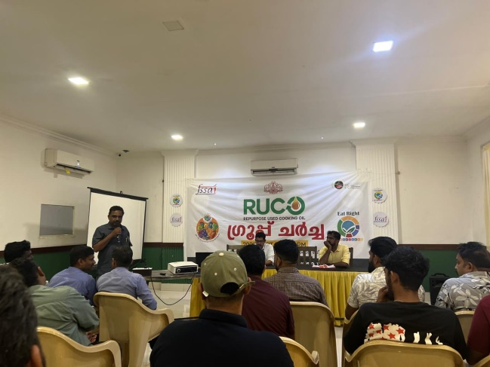
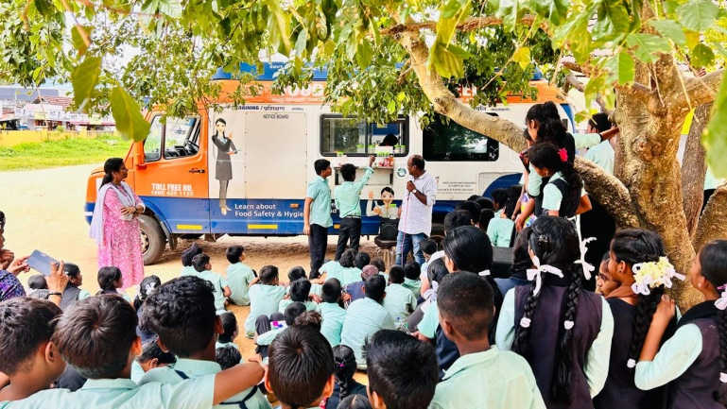
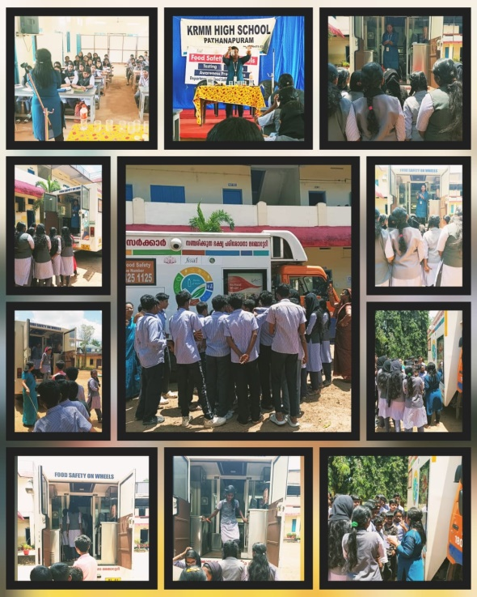
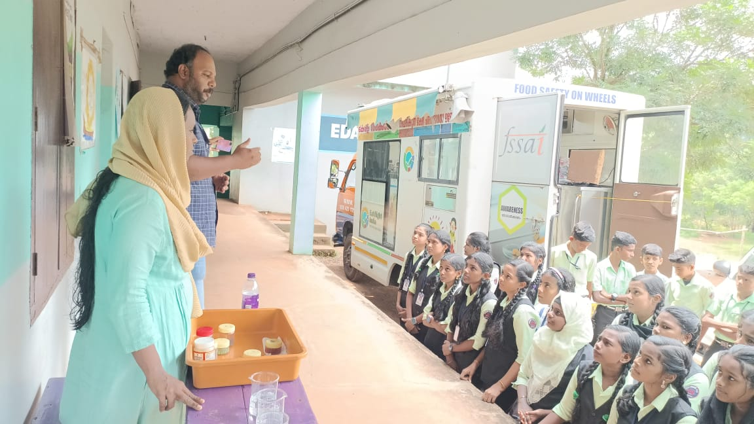
IEC ACTIVITIES
Food safety department ,Kerala plays a pivotal role in spreading awareness about food safety and promoting a safe food handling and consumption. Through a series of IEC activities like FSSAI initiatives ,State initiatives, FSW, the department reaches a wide audience, including FBOs, consumers and general public.

Slide 30
Niramalla Ruchi (നിറമല്ല രുചി)- ‘Say no to synthetic food colour’ campaign
The Food Safety Department has launched a significant initiative titled Niramalla Ruchi in Kozhikode, aimed at raising public awareness about the harmful effects of synthetic food colors and promoting the use of natural alternatives. The Food Safety Department has observed a significant rise in the misuse of synthetic food colors across various food items, leading to numerous prosecution cases in Kozhikode. Many of these cases involve the use of non-permitted synthetic colors or exceeding the permissible limits set by the Food Safety and Standards (FSS) Act 2006 and regulations. Among the alarming findings was the use of synthetic food colors in jaggery, a commonly consumed product. In response to these violations, the department launched an impactful campaign titled Niramalla Ruchi, with the slogan Say No to Artificial Colours.
Key objectives:
Educating the public food business operators, and food handlers about the dangers of synthetic food colors.
Encouraging food businesses to adopt natural food coloring
Ensuring compliance with FSS Act ,which regulates the permissible levels of synthetic food colors in food
Key features:
Public Awareness campaigns –include workshops ,seminars and advertisements on the harmful impacts of synthetic food color
School engagement programs
Collaborations with local food Establishments
Monitoring and inspections
Impact: Since the launch of Niramalla Ruchi, the Kozhikode Food Safety team has observed a positive shift in the local food industry. Many vendors have voluntarily adopted the use of natural food colors, and consumers are increasingly opting for food items free from synthetic additives. The campaign has helped reduce the number of prosecution cases related to food color violations, contributing to a safer and healthier food environment. The campaign’s success is not only measured by enforcement but also by its ability to foster a culture of food safety and public health awareness.

Slide 31
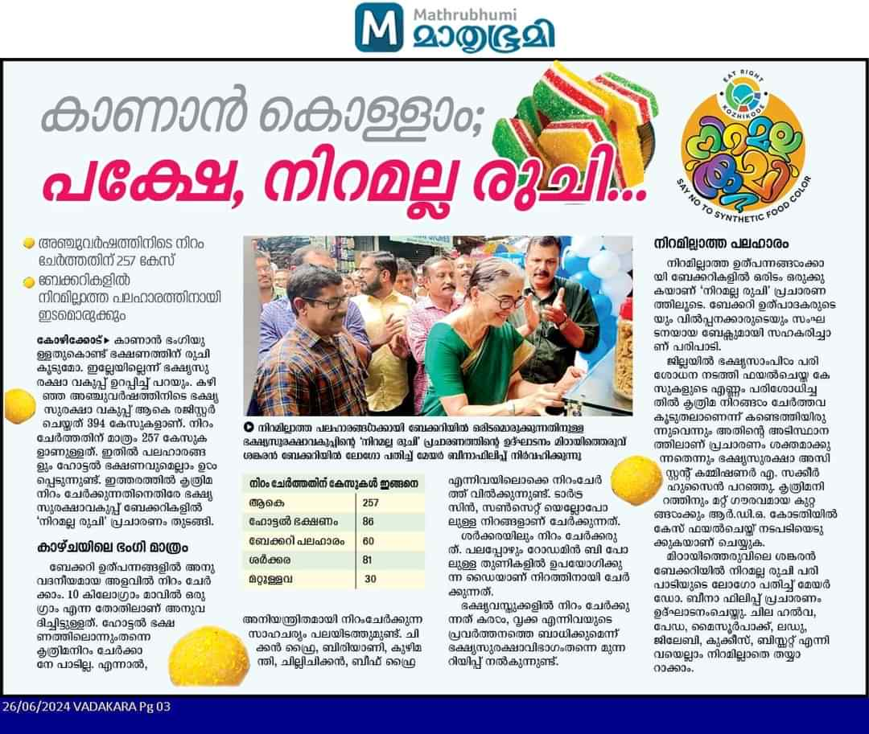
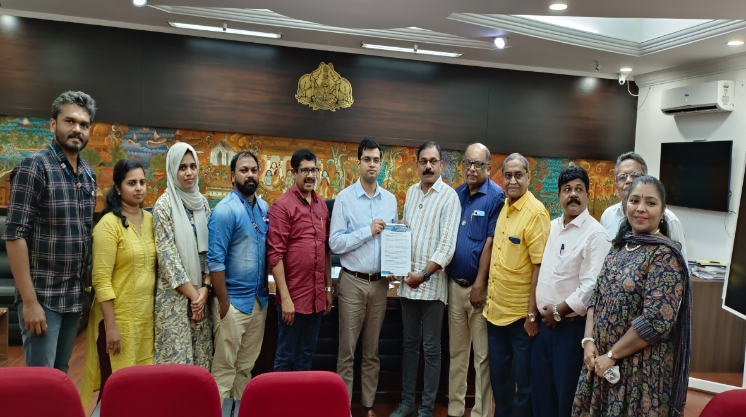
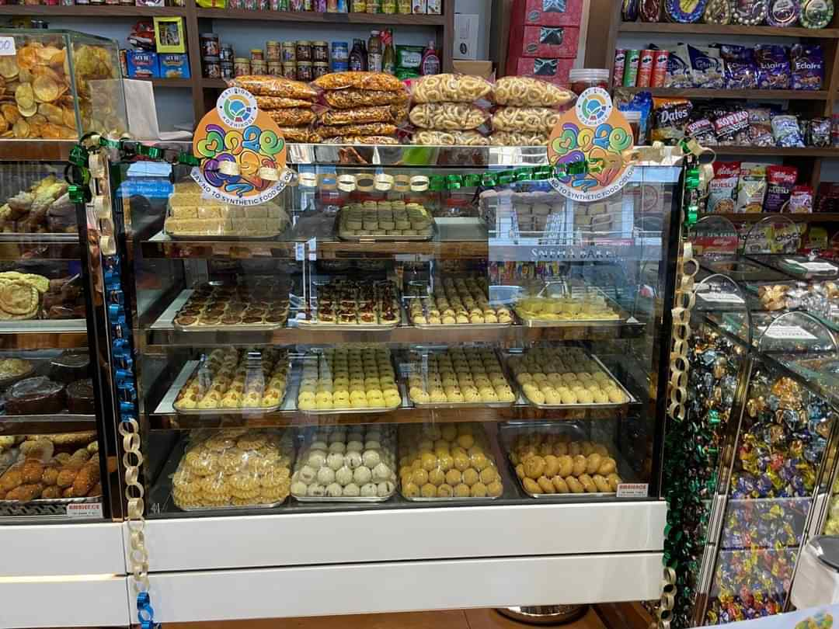
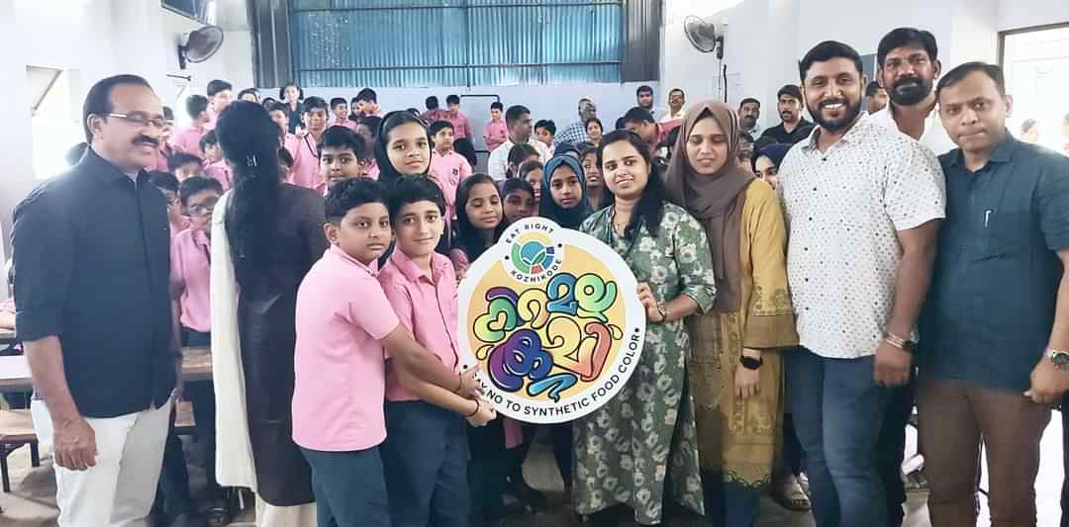
Niramalla ruchi (നിറമല്ല രുചി)- ‘Say no to synthetic food colour’ campaign

Slide 32
Nellika (നെല്ലിക്ക) Campaign- Malappuram’s path to curb life style diseases
The Food Safety Department along with District administration has launched a forward-thinking initiative called Nellikka in Malappuram district,aimed at combating the rise of lifestyle diseases such as diabetes, hypertension, and heart disease. The Nellikka campaign focuses on promoting healthier food choices by encouraging the reduction of oil, salt, sugar, and synthetic food colors in daily diets.
Key objectives:
Creating awareness about the dietary factors contributing to lifestyle diseases and to empower the public with the knowledge to make healthier food choices.
Encouraging dietary modifications by reducing the use of salt ,sugar oil and synthetic food colour
Promoting healthier food habits to reduce the risk of lifestyle diseases such as diabetes, hypertension, and heart disease.
Impacts:
Training for 240 trauma care volunteers was conducted. A multimedia approach is being used to spread the message of Nellikka. Social media platforms, radio broadcasts, and print media are utilized to reach a wider audience.The Nellikka campaign has the potential to bring about a significant positive impact on public health in Malappuram. By educating the community about the dangers of excessive oil, salt, and sugar consumption, and the risks associated with synthetic food colors, the campaign aims to reduce the incidence of lifestyle diseases in the region. The long-term goal is to foster a culture of health-conscious eating habits that will contribute to a healthier population.

Slide 33
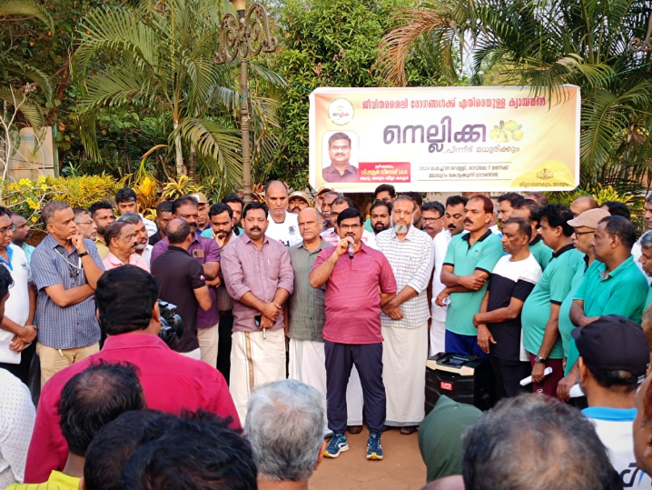

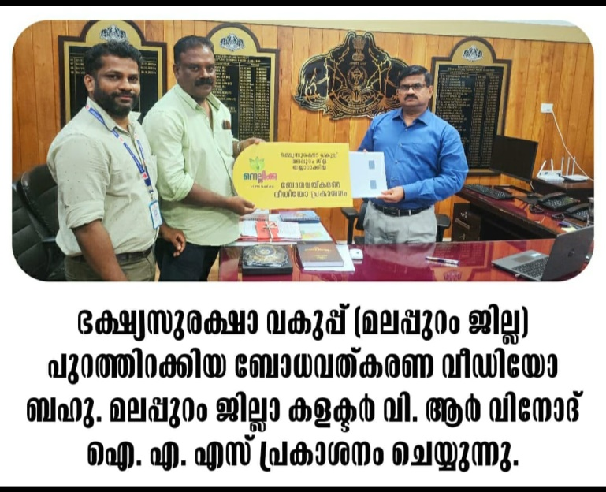

Slide 34
SETTING OF MICROBIOLOGY LAB
On February 25, 2024, Hon. Prime Minister Shri. Narendra Modi dedicated two, national-level microbiology laboratories to the state. Set up for the state food safety department, the laboratories had been made operational at Regional Analytical Laboratory, Ernakulam and Regional Analytical Laboratory, Kozhikode. The Prime Minister inaugurated the laboratories at a virtual function on 25th February 2024.
Under a Central Sector Scheme launched by the Food Safety Standards Authority of India to strengthen food testing labs, Rs 4.5 crore was allocated for upgrading each of the food testing labs in the state. For this, FSSAI invited tenders and selected four vendors acros the country. Work order was awarded to the L1 bidder M/s Asian Scientific Industries, New Delhi with the approval of FSSAI to carry out the Setting up of Microbiology Section and installation of Equipment on Turnkey Basis in Regional Analytical Laboratory, Ernakulam. This 4.5 crore rupees sanctioned for the labs will cover the expenses for infrastructure, equipment and on-contract human resources for three years. The state government played a huge role in the timely completion of the construction and infrastructure development for the project. Since a 150KV electricity power connection was required for the functioning of the Microbiology lab, the state government took initiative and allocated funds from its annual plan to install a required high-tension transformer.
Microbiology testing plays a crucial role as per FSSAI norms. Currently NABL approval is available only for the chemical department in state food testing labs. Once the new microbiology labs start functioning, and get accredited by the NABL, Kerala will be able to attain a higher standard in food testing.

Slide 35
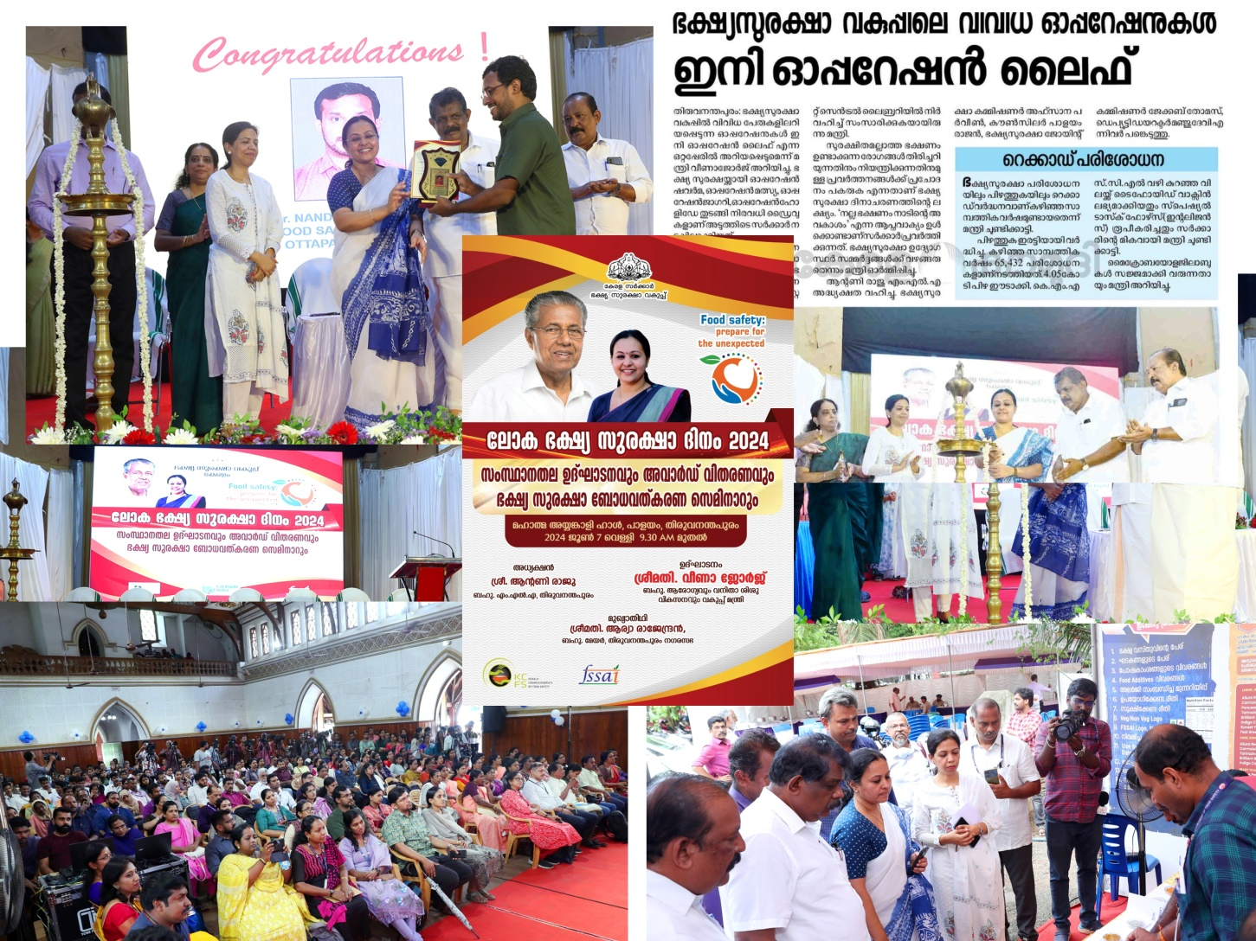
World Food Safety Day celebration-June 7,2024

Slide 36
Kerala Secures First Rank in the 2024 State Food Safety Index for the Second Consecutive Year
ACHIEVEMENT
In a remarkable achievement, Kerala has once again secured the first rank in the State Food Safety Index (SFSI) 2024, continuing its leadership in food safety standards for the second consecutive year. This consistent top performance underscores the tireless efforts and strategic initiatives of the Kerala Food Safety Department, which has worked diligently to improve food safety measures across the state. This achievement also reflects the commitment of the state government toward ensuring the health and well-being of its citizens through safe and nutritious food. By maintaining this momentum, Kerala is well-positioned to continue leading the way in food safety for years to come.

Slide 37


